Slide 1
Coloplast- An update on Trans- Anal Irrigation
Peristeen

Slide 2
Agenda
Health Economic Burden of Bowel
Trans Anal Irrigation- An Intro
Patient Types & Experience
Efficacy and Safety Update
Coloplast Patient Support Programmes

Slide 3
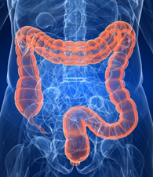
Bowel Problems are extremely common...
2.5 Million People in the UK Suffer from Chronic
Constipation
1-10% of the population suffer from Faecal
Incontinence
=

Slide 4
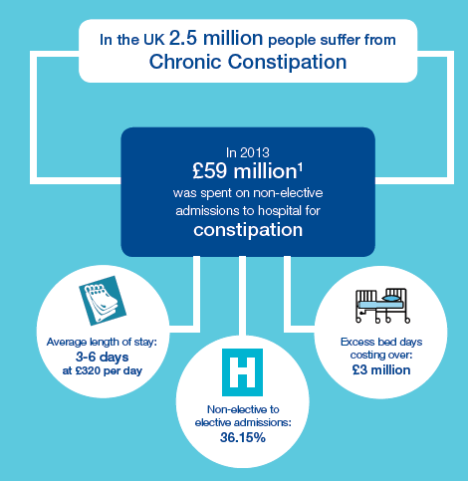

Slide 5
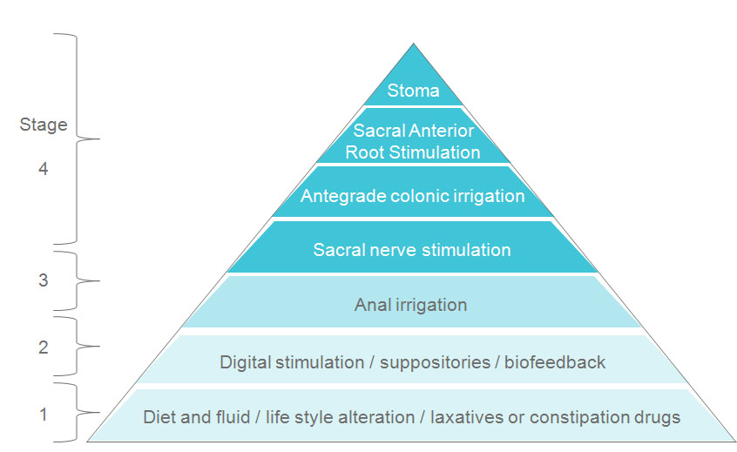
Awareness of Treatment Options remains low
50% of patients do not respond to Laxative treatment yet over 17 Million Laxatives items were prescribed last year

Slide 6
Trans Anal Irrigation
Peristeen Anal irrigation (PAI), also known as trans-anal irrigation or rectal irrigation is a unique way of emptying the lower bowel and is used to prevent chronic constipation and faecal incontinence or simply as a method of bowel management.
http://my-bowel.co.uk/treatments/peristeen-anal-irrigation-pai/

Slide 7
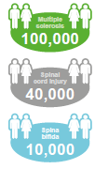
Patient Types
http://my-bowel.co.uk/real-life-stories/ms/
Functional
Functional bowel dysfunction
is the term used to describe a
condition of the bowel where
the function is disrupted, eg
slow transit gut, haemorrhoids,
tumour, pelvic organ prolapse.
Neurogenic
Neurogenic Bowel Dysfunction
arises as a result of an
interruption to the nerve
pathways supplying the bowel,
eg in Multiple Sclerosis,
Spina Bifida, Spinal Cord Injury,
Parkinson’s Disease.

Slide 8
Clinical Efficacy
14,000 Patients have used Peristeen in the UK and Ireland
Over 20 Papers now detailing the use of Peristeen and its efficacy
Data available for Peristeen’s use in Neurogenic & Functional patients >3 years of age
Proven to work in 2/3 patients who have failed Conservative Bowel Management

Slide 9
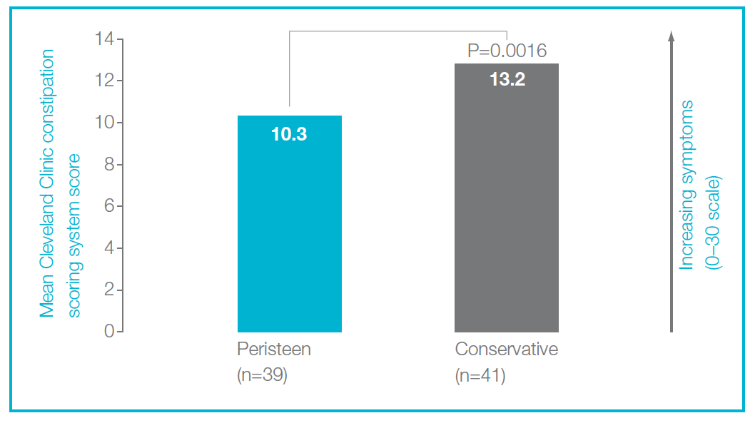
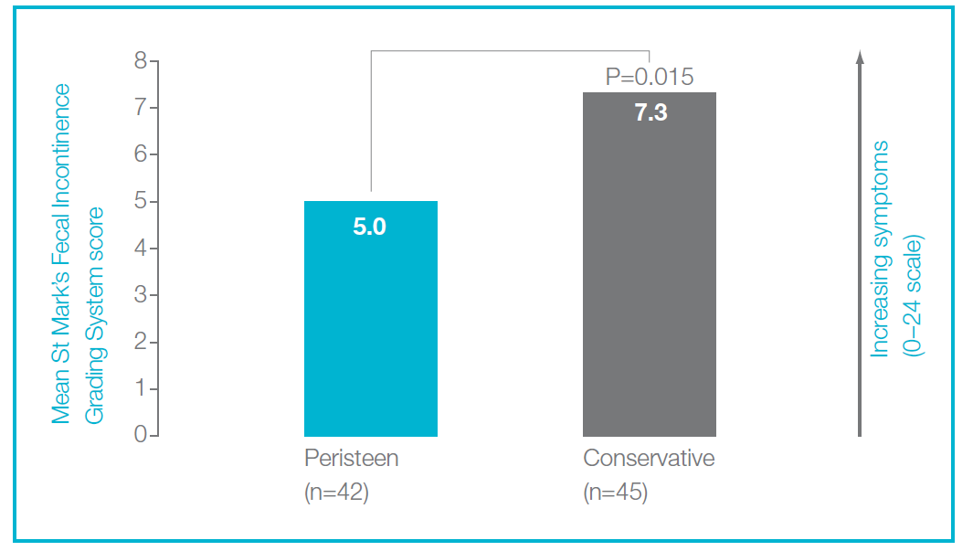
Peristeen® significantly reduced symptoms of constipation and faecal incontinence vs. conservative bowel management
Christensen P, et al. Gastroenterology 2006;131:738–747

Slide 10
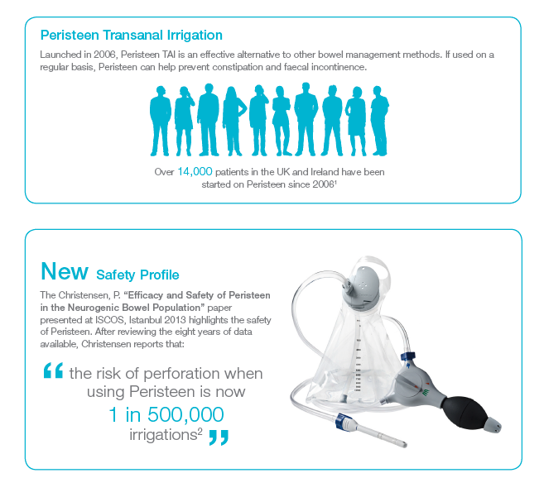
Safety

Slide 11
Coloplast CARE- Patient Support Programme

Slide 12
The Peristeen Advisory Service- 16 Nurses Nationally

