Slide 1


Chartered Physiotherapists Promoting Continence
Advances in Surgery for Faecal Incontinence
David Jayne
Professor of Surgery
University of Leeds & Leeds Teaching Hospitals NHS Trust
John Goligher
Colorectal Unit

Slide 2
Faecal Incontinence
One of the most humiliating experiences an individual is likely to encounter
FI is a sign or symptom, not a diagnosis
Affects 1% - 10% of adults
0.5% - 1.0% experience regular FI affecting quality of life

Slide 3
Faecal Incontinence
Increasing incidence with age
Population-based studies
  <40yrs: UI 9%; FI 5.3%
  > 60yrs: UI 19%; FI 9.7%
Linked to urinary incontinence and pelvic organ prolapse
  Risk of FI in patients with UI = 1.8
  Risk of FI in patients with UI + POP = 4.6

Slide 4
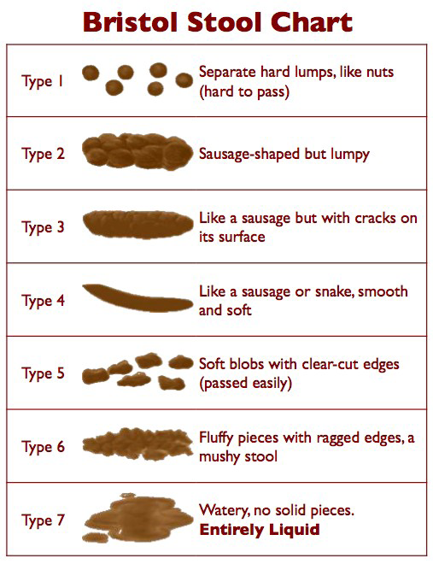
Pathophysiology
Complex, multifactorial aetiology
Stool frequency
Stool consistency
Rectal sensitivity
Rectal evacuation
Anal sphincter dysfunction

Slide 5
Terminology
Faecal incontinence
  Incontinence of liquid or stool
Anal incontinence
  Incontinence of flatus
Urge Incontinence: loss of faeces due to inability to suppress an urgency to defaecate
Passive Incontinence: loss of faeces without patient’s awareness

Slide 6
Patient Evaluation
Patient centred approach considering individual needs and preferences
Detailed initial assessment
Structured approach to management
Address simple, reversible factors
Specialist referral where appropriate

Slide 7
History
  Frequency of incontinent episodes
  Stool consistency – Bristol stool chart
  Use of medications
  Use of incontinent aids / pads
  Impact on quality of life
  Passive &/or urge incontinence
  Surgical history
  Co-morbidities
    Neurological conditions, spinal injuries, obstetric injury, cognitive impairment, pelvic organ/rectal prolapse etc

Slide 8
Grading
Cleveland Clinic Incontinence Score (CCIS)
 | Never | Rarely | Sometimes | Usually | Always
Solid | 0 | 1 | 2 | 3 | 4
Liquid | 0 | 1 | 2 | 3 | 4
Gas | 0 | 1 | 2 | 3 | 4
Pads | 0 | 1 | 2 | 3 | 4
Lifestyle | 0 | 1 | 2 | 3 | 4

Slide 9
Examination
External appearance
  Patulous anus, Perianal scarring, Excoriation
Digital rectal examination
  Perianal sensation
  Resting sphincter tone
  Squeeze ability
  Sphincter integrity
Rigid sigmoidoscopy
  Exclude colitis, malignancy etc.

Slide 10
Investigation
Colonic imaging
  Flexible sigmoidoscopy, colonoscopy
Anorectal manometry
  Resting pressure
  Squeeze increment
  High pressure zone
  Vector profiles
  Pudendal Nerve Terminal Motor Latencies (PNTML)
Endoanal ultrasound
  Internal anal sphincter
  External anal sphincter

Slide 11
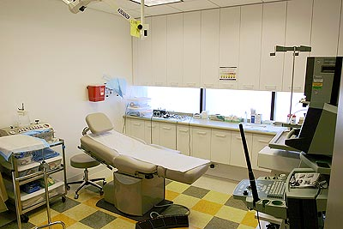
Anorectal Physiology & EAUS

Slide 12
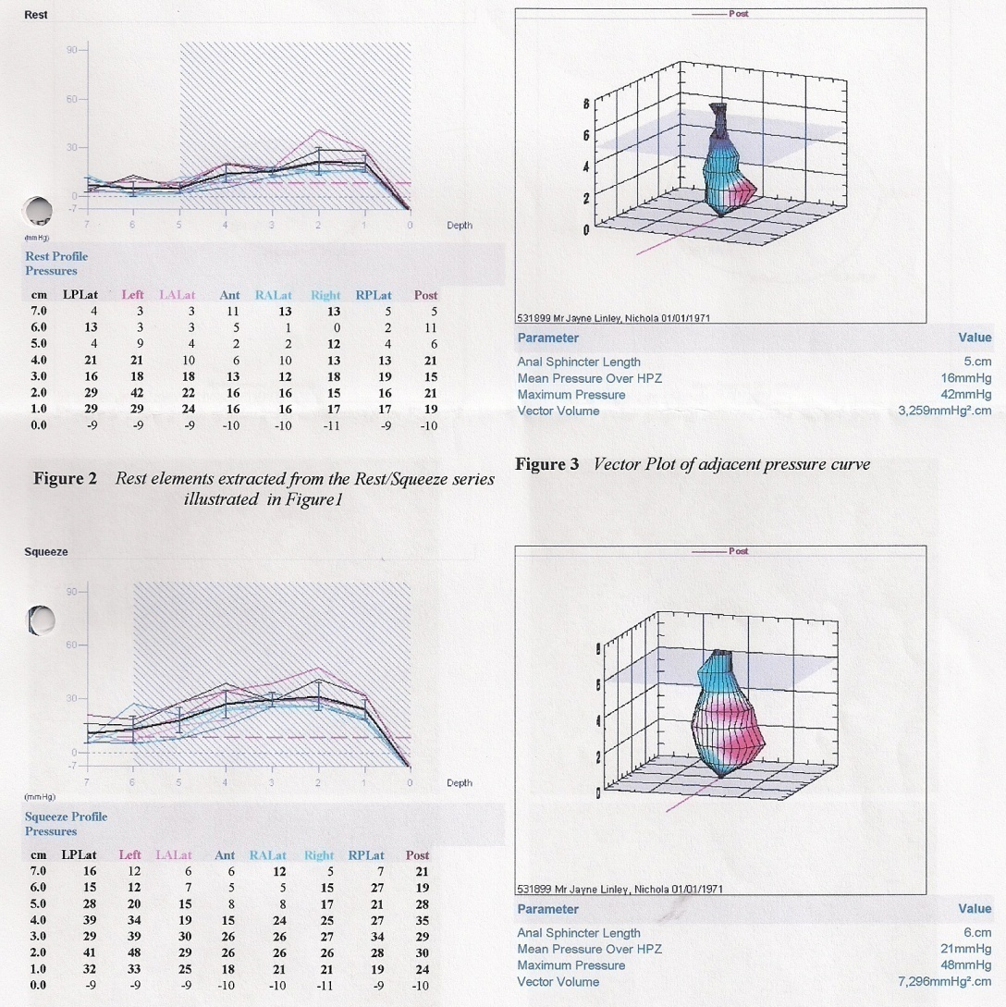
AR Physiology

Slide 13

Normal values
Resting pressure male 50 – 120 mm Hg
Resting pressure female 30 – 100 mm Hg
Squeeze pressure male 140 – 400 mm Hg
Squeeze pressure female 75 – 250 mm Hg
Volume first aware 10 – 30 ml
Maximum tolerated volume 100 – 300 ml

Slide 14
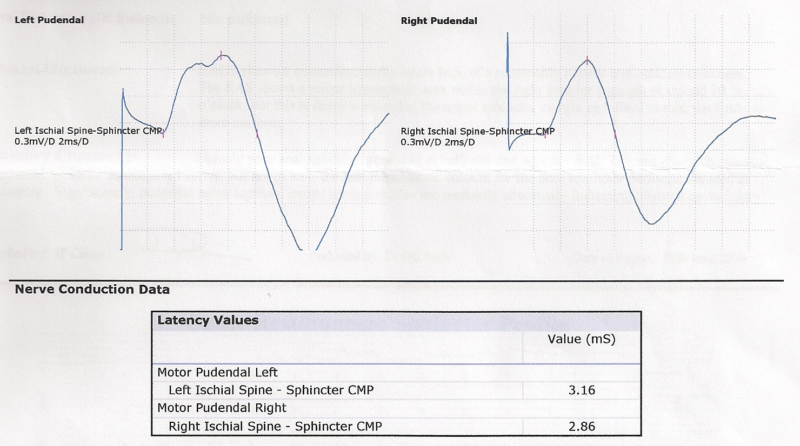
PNTML

Slide 15
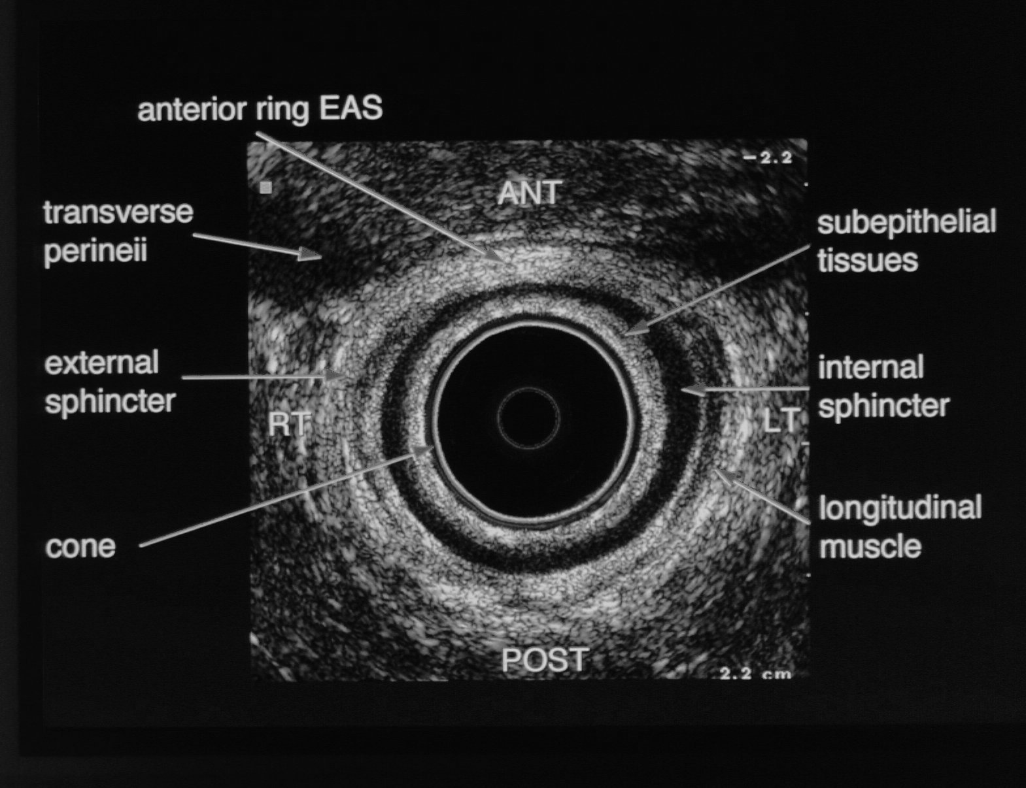
Endoanal Ultrasound Scan

Slide 16
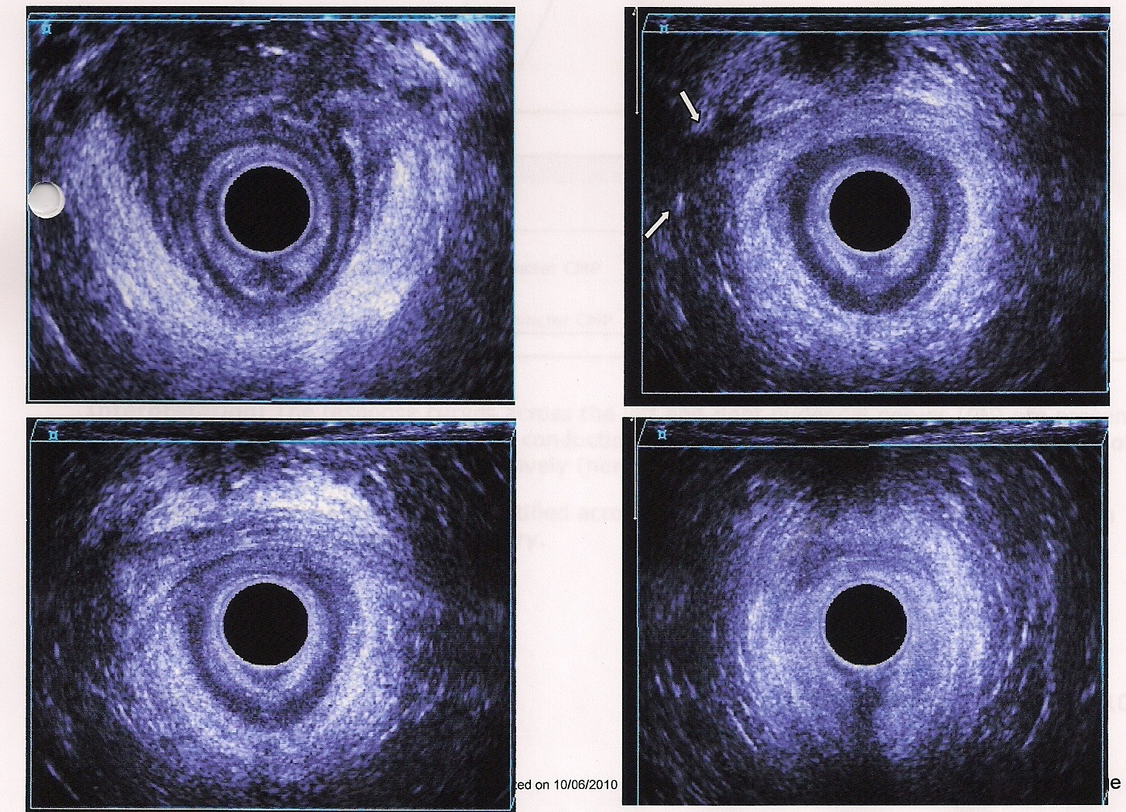
Endoanal Ultrasound Scan

Slide 17
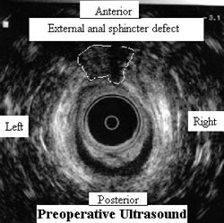
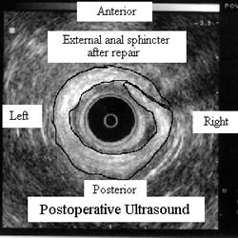
Endoanal Ultrasound Scan
Anterior sphincter injury
Anterior sphincteroplasty

Slide 18
AR Physiology & EAUS
Sphincter defect
  Isolate EAS defect
  Isolated IAS defect
  Combined EAS & IAS defects
Physiological function
  Ext. sphincter weakness consistent with EAUS
    Urge incontinence
    Co-existent pudendal neuropathy
  Int. sphincter weakness consistent with EAUS
    Passive incontinence

Slide 19
Classification
Loose stools & IBS
Passive incontinence
Sphincter failure
Rectal prolapse

Slide 20
Loose stool & IBS
Defaecatory frequency with loose motions
Typical individuals experience great anxiety about leaving the house
Worse in the morning
Virtually never causes nocturnal incontinence
More the individual concerned the worse the problem
Other IBS symptoms; otherwise healthy

Slide 21
Loose stool & IBS
Overactivity of intestine – esp. colon in response to normal factors that provoke colonic contractions
  Getting up in the morning
  Eating
  Exercise
  Anxiety and stress
Exacerbated by dietary factors –
  Very rarely due any true sensitivity

Slide 22
Loose stool & IBS
Treatment
  Exclusion of serious pathology
    colitis, malignancy, coeliac disease etc.
  Explanation and reassurance
  Dietary/Lifestyle modification
  All aiming for more solid stool
    Antispasmodics e.g. Mebeverine
    Constipating agents e.g. Loperamide / codeine
    Bulking agents e.g. Fybogel

Slide 23
Passive Soiling
Unconscious seepage of soft stool
Occurs shortly after bowel movement
Leads to perianal skin irritation and itching
Men
Direct result of soft stool which cannot be expelled efficiently
May occur in combination with obstructed defaecation

Slide 24
Passive Soiling
No evidence of weak sphincter – in fact longer and stronger sphincter
Mechanism is thought to be presence of a small amount of stool within the lower rectum
Triggers the RAIR – causes relaxation of the internal sphincter
Results in small amount of faeces in anal canal which will leak out

Slide 25
Passive Soiling
Aim of treatment is to achieve more complete rectal evacuation
  firm up stool
  +/- suppositories, enemas
In cases of IAS defect, anal key-hole deformity
  Consider IAS bulking agents

Slide 26
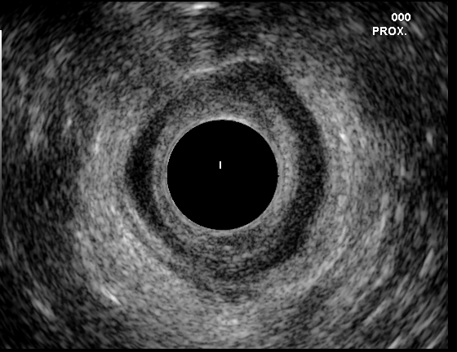
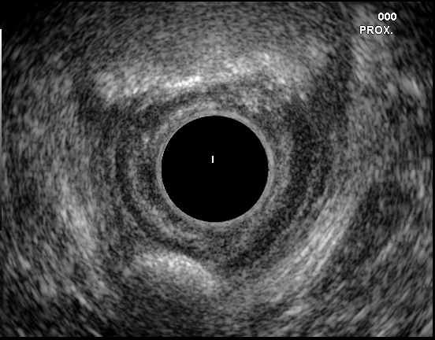
IAS Bulking Agents

Slide 27
Sphincter Failure
Accounts for about 5% of all cases
Obstetric Injury
Surgery
Trauma
Neurogenic / spinal cord lesion
Infection
Rectal Prolapse

Slide 28
Sphincter Failure
Specialist evaluation is important to determine if a surgically correctable cause is present.
Obstetric and Prolapse most likely to benefit from surgery
Basic rule still applies:
KEEP THE STOOL SOLID AND THE RECTUM EMPTY

Slide 29
Treatment
Conservative management
  Dietary modification
  Bulking and constipating agents
  Rectal enemas
  Irrigation techniques
  Biofeedback therapy

Slide 30
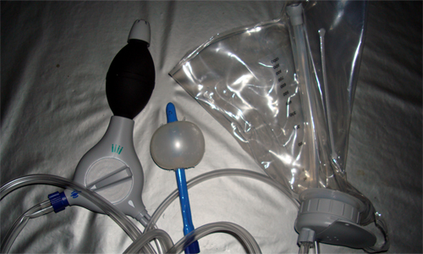
Rectal Irrigation

Slide 31
Treatment
Surgical Intervention
  Anterior sphincteroplasty
  Sacral Nerve Modulation
    Posterior Tibial Nerve Stimulation
  Graciloplasty
  Artificial Bowel Sphincter

Slide 32
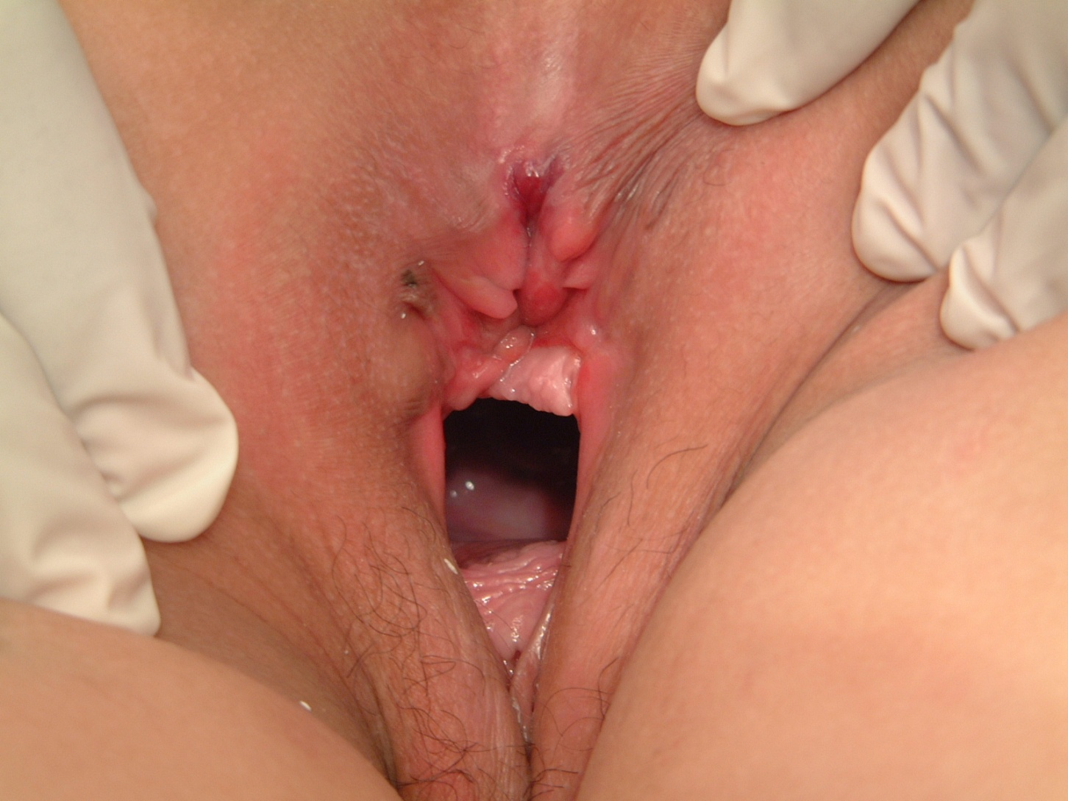
Anterior Sphincteroplasty

Slide 33
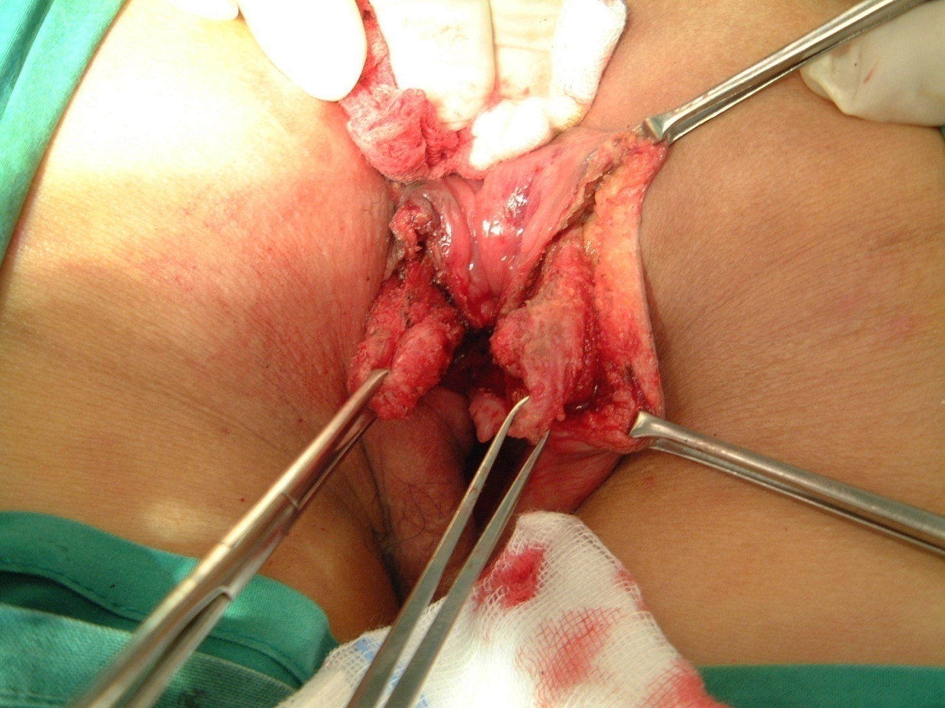
Identification of EAS/IAS

Slide 34
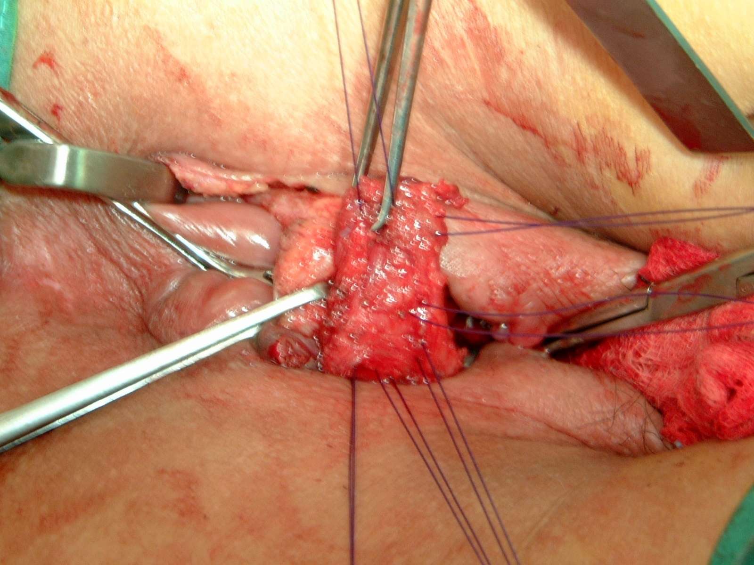
Mobilisation of EAS

Slide 35
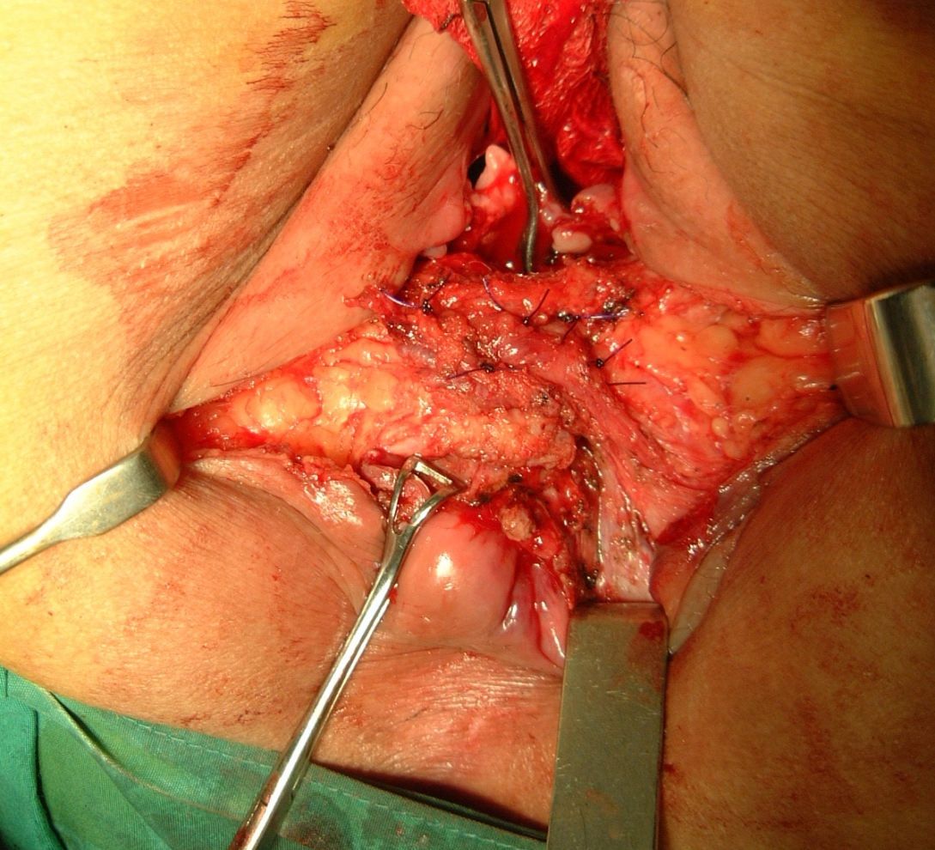
Overlapping Repair

Slide 36
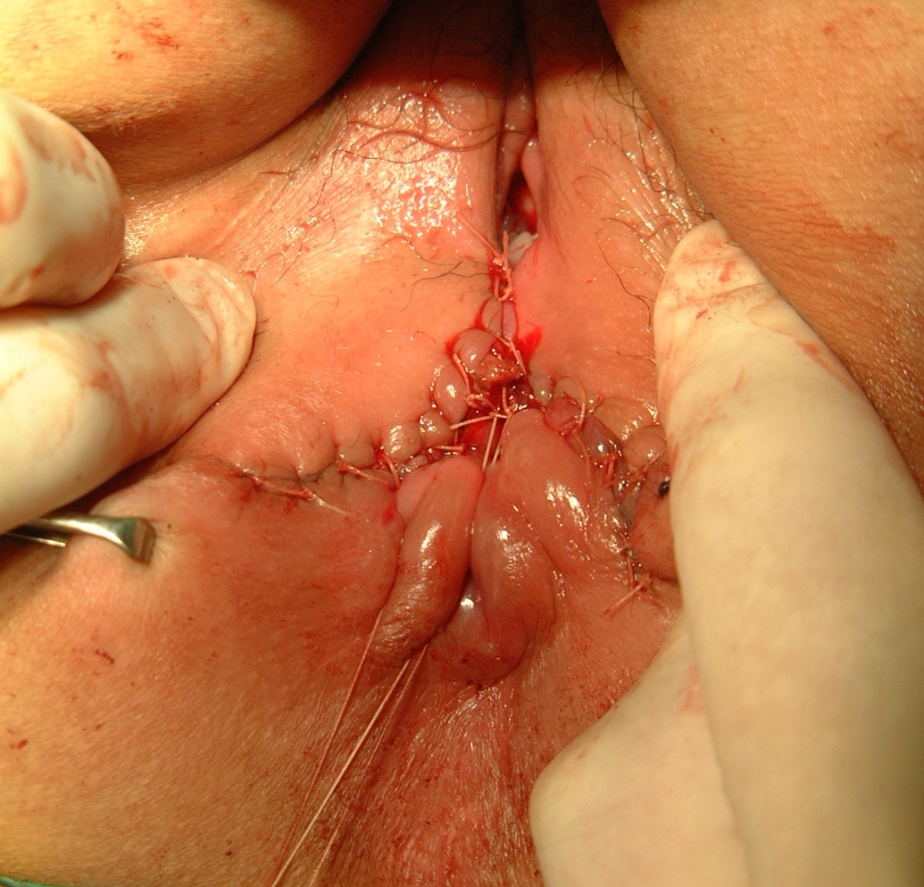
Perineal Reconstruction

Slide 37
Anterior Sphincteroplasty
Short-term results
Reasonable
70% improved continence at 2 years follow-up
Long-term results
Deteriorate with age
50% improved continence at 5 years follow-up
Worse with:
  Large sphincter defect; multiple defects; atrophy; pudendal neuropathy
Notes:
Anterior sphincter defect is the commonest form of injury and anterior sphincter repair is by far the commonest surgical procedure undertaken.
Initial reports suggested a success rate of 75-90% but more recent reports Lancet St Marks 50%.
If however a sphincter is divided a repair is the first initial treatment and can be supplemented with biofeedback if success tails off. It seems likely that the neuropathy commonly seen in these patients underlies the deterioration with time and will be ongoing as these patients age.
In thse patients with a poos result many will be satisfied with a stoma end not loop but theses too can stiill have there problems with mucus leakage and itcha nd excoriation that may merit rectal excision.

Slide 38
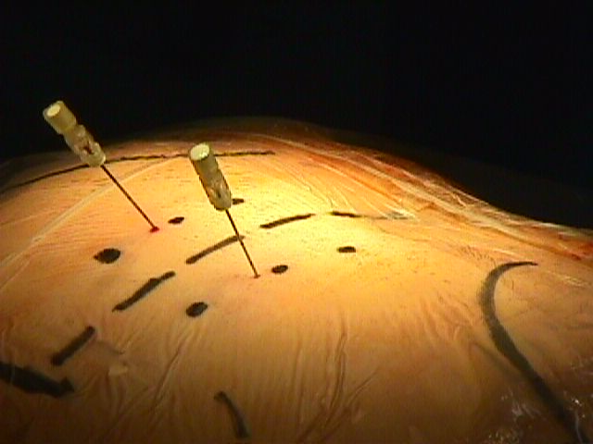
Sacral Nerve Modulation
S2
S3
S4
Sciatic notch
Posterior Iliac Spines

Slide 39
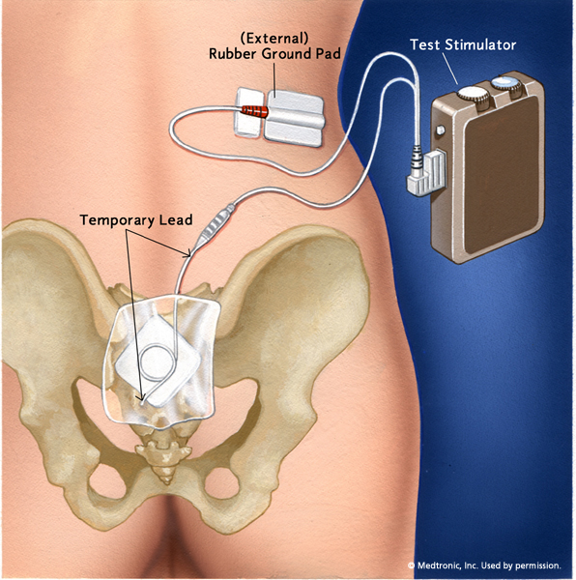
Sacral Nerve Modulation
Test stimulation
S3 stimulation
Anal & toe response
2 weeks
Bowel diary
50% improvement

Slide 40
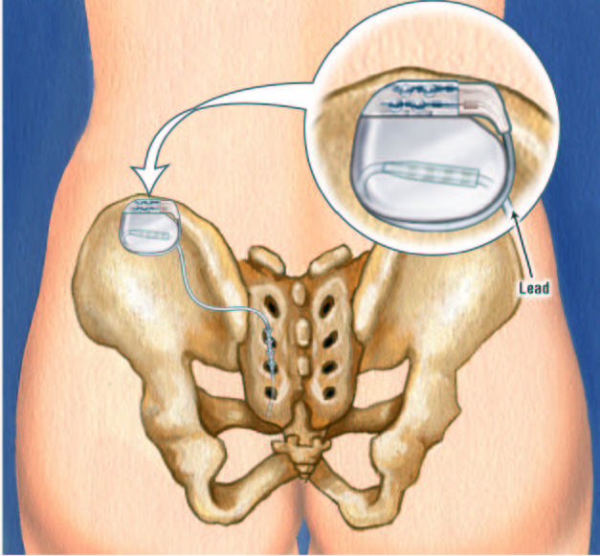
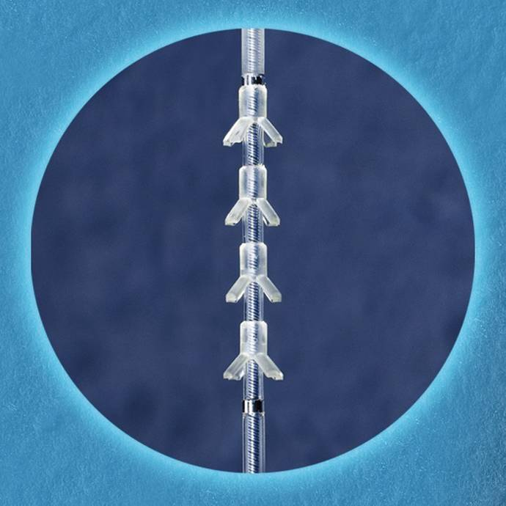
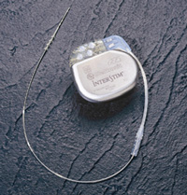
Sacral Nerve Modulation
Permanent Implant
S3 implant
Interstim buried in
buttock
Remote programmer

Slide 41
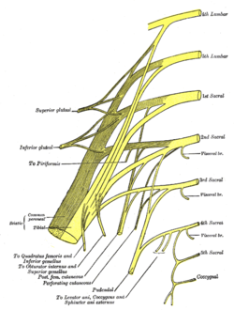
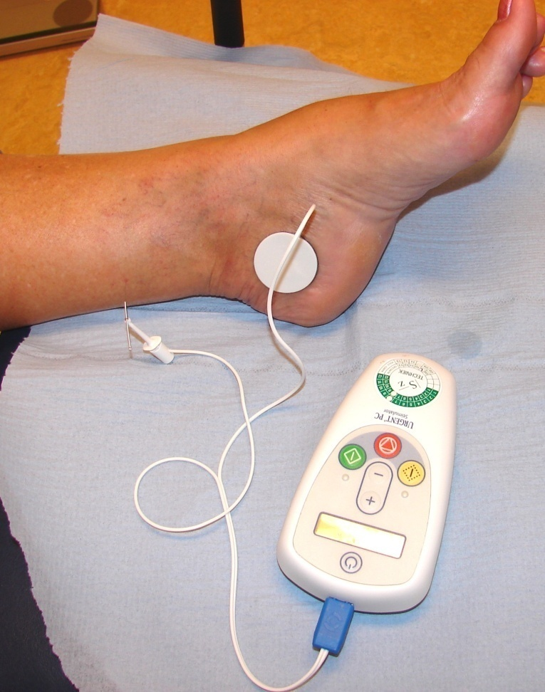
Posterior Tibial Nerve Stimulation

Slide 42
Treatment Options
Complex 2nd line Surgery
  Stimulated gracilis neo-sphincter
  Artificial bowel sphincter
Notes:
Patients who fail the therapeutic strategies outlined above need to be considered for more complex surgery and therefore need to be assessed in a unit with experience of these.

Slide 43
Stimulated Gracilis
Gracilis muscle is mobilised
α/γ wrap configuration is used
Neurovascular bundle identified
Chronic nerve stimulation coverts the fast twitch muscle to a slow twitch muscle
Requires defunctioning stoma during period of adaptation

Slide 44
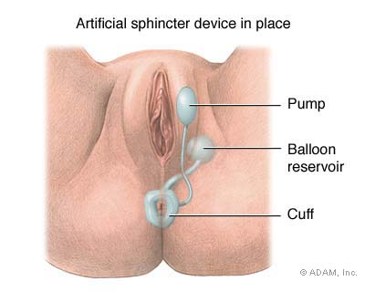
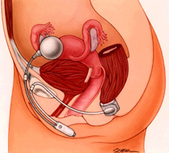
Artificial Bowel Sphincter

Slide 45
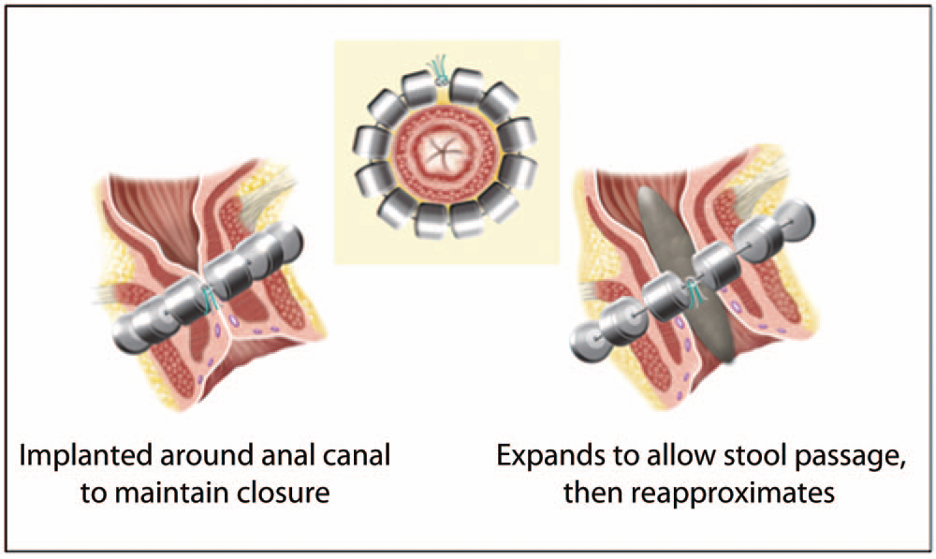
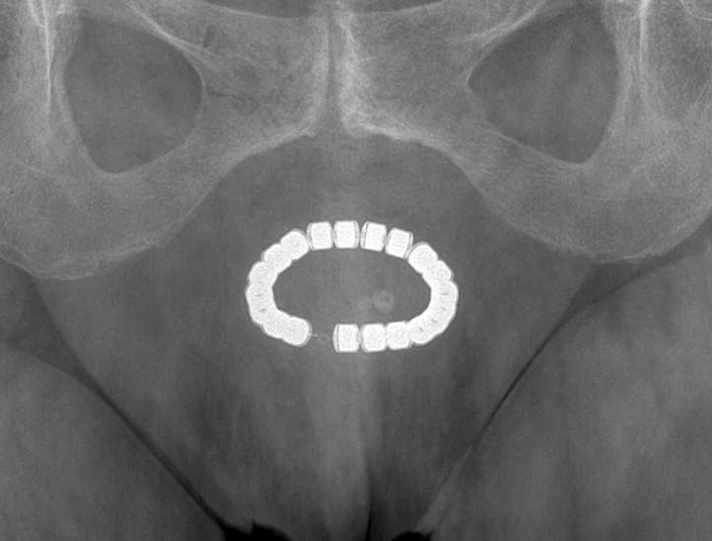
Magnetic Anal Sphincter Augmentation

Slide 46
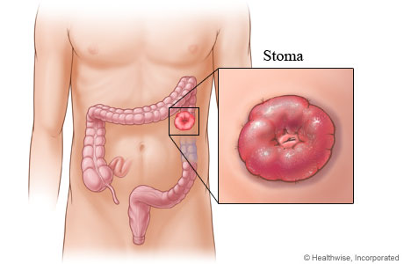
Stoma
Often considered treatment of last resort
Better a continent stoma than an incontinent bottom
QoL often better

Slide 47
NIHR HTA Surgery call 2012
Ideal opportunity to undertake rigorous prospective evaluation of new technology prior to widespread adoption in NHS
Fenix MAS v SNS for treatment of adult faecal incontinence

Slide 48

Objectives
Short-term safety and efficacy of FENIX and SNS
Impact of FENIX and SNS on QoL and cost effectiveness

Slide 49
Primary outcome
Proportion of patients with FENIX or SNS in situ at 18-months follow-up and with ≥50% improvement in CCIS
Secondary outcomes
Length of stay
Complications
Re-interventions
Consitpation
QoL
Cost effectiveness

Slide 50
Design
UK, multi-centre, prospective, parallel-group, randomised controlled, unblinded study
350 patients (randomised 1:1)
Eligibility
Failed medical management
Moderate to severe FI
  Incontinence > 6 months, suffering ≥2 incontinent episodes per week

Slide 51
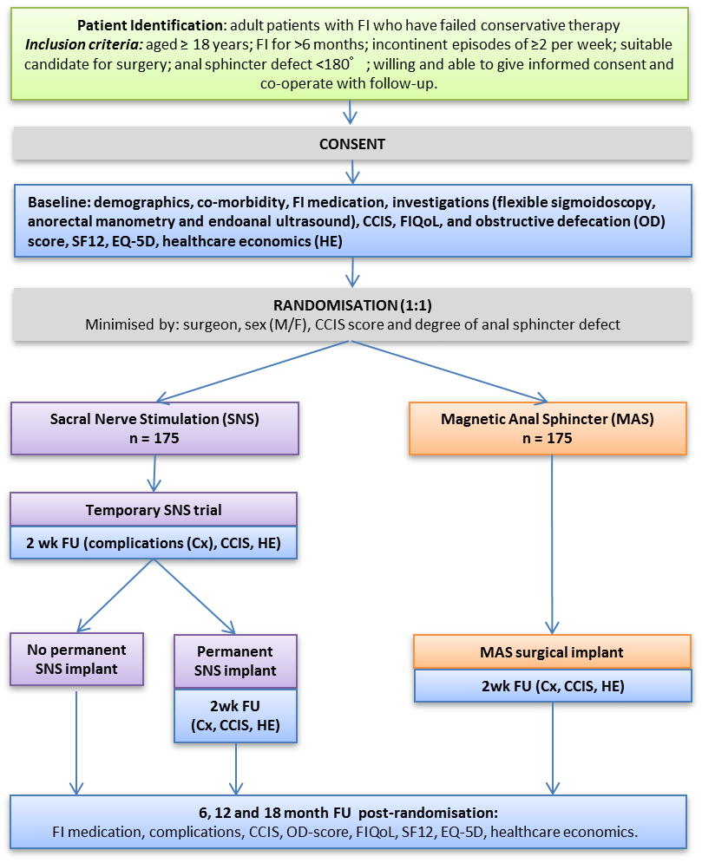

Slide 52

IMPRESS Network
Incontinence Management and PRevention through Engineering and ScienceS
ENTERIC Bowel Function HTC (London)
D4D HTC (Sheffield)
Colorectal Therapies HTC (Leeds)

Slide 53
Academia
Colorectal Therapies
HTC
Clinical Network
Colorectal
Technology
Clinical Adoption
Commercial Translation
D4D
HTC
Patient Engagement
Urinary Continence
Management
Enteric
HTC
Faecal Continence
Management
Commercial
Adoption
Patients
Clinicians
Academic
Technology
Advocates
Academic Network:
Science + Engineering Expertise

Slide 54

IMPRESS plans
STAGE I - Learning and Information Exchange; Educating Scientists and Engineers
- Technology advocates recruited. “Teachers” – to convey aetiology, physiology, anatomy, biomechanics, biology and biochemistry of incontinence
STAGE II – Health Care Professional Shadowing
- Appreciate first hand the complexities and diversity of incontinence conditions
STAGE III – Patient Focus Groups
- A series of “exchange sessions” with patients
STAGE IV – Expanding the Network to Solve Problems – starting at month 12
STAGE V – Proof of Concept Projects
CONTACT: PROF ANNE NEVILLE a.neville@leeds.ac.uk

Slide 55
Summary
Faecal incontinence: a common, under-reported condition
Multifactorial aetiology
Careful patient-centred assessment
Many causes simple and reversible
Refractory cases referred for specialist opinion
Expanding array of surgical options & research opportunities

Slide 56
Chartered Physiotherapists Promoting Continence
Advances in Surgery for Faecal Incontinence
David Jayne
Professor of Surgery
University of Leeds & Leeds Teaching Hospitals NHS Trust
John Goligher
Colorectal Unit

