Slide 1
CPPC Study Day, Nov 2011
Diane Stark
Specialist Practitioner
Functional Bowel Service
Leicester Royal Infirmary

Slide 2


A Multicentre Randomised Controlled Trial of a Pelvic Floor Muscle Training Intervention for Women With Pelvic Organ Prolapse
Suzanne Hagen, Diane Stark, Cathryn Glazener , Lesley Sinclair, Don Wilson, John Norrie,
Sylvia Dickson, Gladys McPherson, Janet Logan, Helena Frawley, Kate H Moore,
Andrew Walker
Nursing, Midwifery and Allied Health Professions Research Unit, Glasgow
Southern General Hospital, Glasgow
Health Services Research Unit, Aberdeen
Dunedin School of Medicine, University of Otago
University of Glasgow
University of Melbourne
St George Hospital, University of New South Wales
Funded by the Chief Scientist Office, Scottish Government;
National Health and Medical Research Council, Australia; Lottery Grants Board, New Zealand

Slide 3

- the journey
 | Jan | Feb | March | April | May | June | July | August | Sep | Oct | Nov | Dec
2002 |  |  |  |  |  |  |  | VCV
2003
2004
2005
2006
2007
2008
2009
2010
2011
EXAMPLE TEXT
FEASIBILITY - ETHICS
FEASIBILITY FUNDING - CSO
FEASIBILITY STUDY
EXAMPLE TEXT
POPPY FUNDING APPLICATION - CSO
PHYSIO DAY
ETHICS/R&D
SITE INITIATION VISITS
RECRUITMENT
CSO
CSO
DATA COLLECTION & ANALYSIS
PRESENTATION OF RESULTS/PUBLICATIONS
POPPY Feasibilty
POPPY main trial
Ethics R&D applications
Main trial recruitment
Site initiation visits
Notes:
This slide takes you back almost 10 years to 2002 when the feasibility study for the trial started with recruitment in Aberdeen and glasgow, thro to the main trial which spread across the UK and beyond, to presentation of the results here at ICS. But as a few of you may know the idea for this trial started from a burning clinical question that Diane Stark had even earlier in 1998 – we were brainstorming what would be good research questions to pursue in a joint venture between our unit and group of West of Scotland physios. What to do about the lack of research evidence for physios treating women with prolapse was top of Diane’s list! So it’s been a long journey that has brought us here today.

Slide 4
A United Kingdom-wide survey of physiotherapy practice in the treatment of pelvic organ prolapse.
Hagen S, Stark D, Cattermole D. A. Physiotherapy 2004 Mar;90(1):19-26.
Questionnaire mailed to 484 physiotherapists
  72% response
  92% treating women with prolapse with all elements of PFMT and lifestyle advice
  79% reported no access to guidelines
  >80% interested in being involved in research
Notes:
Collaborative research

Slide 5
Definition of POP
Urogenital prolapse is defined as the symptomatic descent of one or more of: the anterior vaginal wall, the posterior vaginal wall, and the apex of the vagina (cervix/uterus) or vault (cuff) after hysterectomy. Urogenital prolapse is measured using the POP-Q system. (Abrams et al 2009)
Objective findings of prolapse in the absence of relevant prolapse symptoms may be termed “anatomic prolapse”. (Abrams et al 2009)
Notes:
In 2002 there was no such definition available however Swift (2003) highlighted the need for a definition which included reference to symptoms and not only signs. In 2005 this definition was almost the same except it ended “Prolapse support can be staged from stage 0 to IV”. We are concentrating on symptomatic propalse in the POPPY study.
It is clear from this definition that two of the things any study must measure are the symptoms and also the objective measurement of POP. We always had symptoms as our main outcome for POPPY because its arguably the most important factor to the woman presenting for treatment. However there was also a hypothesis (anecdotally based) that the POP-Q might not change however symptoms would.

Slide 6
POP Symptoms
Hagen S, Glazener C, Sinclair L, Stark D, Bugge C. (2009) Psychometric properties of the Pelvic Organ Prolapse Symptom Score (POP-SS). British Journal of Obstetrics and Gynaecology 116: 25-31.
Qualitative study during POPPY feasibility 2003
Notes:
POP-SS was tested in three studies (POPPY on women with symptomatic stage 1 or 11 POP, a study with women about to undergo surgery for POP and thirdly a study with women with unknown prolapse status). Further work has since been undertaken into this symptom questionnaire.

Slide 7
Pelvic Organ Prolapse Symptom Score
How often during the last 4 weeks have you had the following symptoms
A feeling of something coming down from or in your vagina?
An uncomfortable feeling or pain in your vagina which is worse when standing?
A heaviness or dragging feeling in your lower abdomen/tummy?
A heaviness or dragging feeling in your lower back?
A need to strain (push) to empty your bladder?
A feeling that your bladder has not emptied completely?
A feeling that your bowel has not emptied completely?
(0 = never, 1 = occasionally, 2 = sometimes, 3 = most of the time and 4 = all of the time)
All of the time: 4
Most of the time: 3
Sometimes: 2
Occasionally: 1

Slide 8
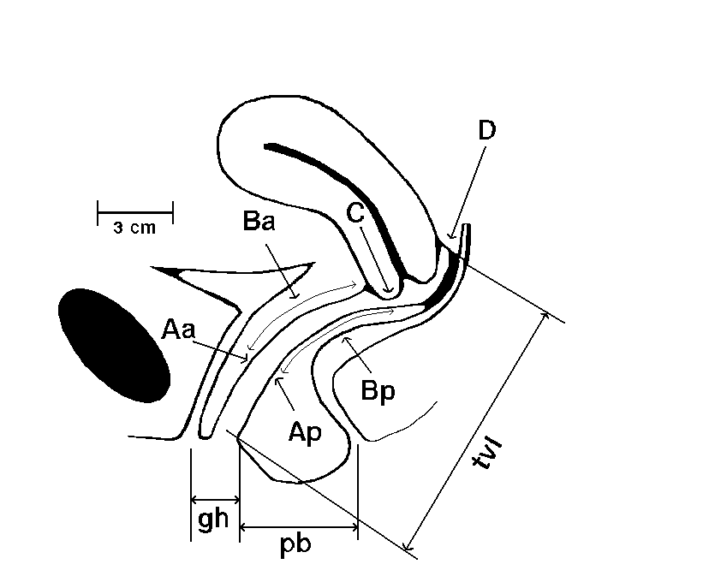
POP-Q Bump 1996
Notes:
We have been through a long journey with POP-Q as part of the POPPY study as it is our only objective outcome measure. This diagram may be familiar to many of you and shows the key points measured. The POP-Q system is the only validated prolapse measuring system validated and recommended by ICS. Although commonly used for research purposes, its clinical use amongst members of ICS and AUGS was shown to be only 42% in a survey by Auwad in 2004.
A survey of Physiotherapists in the UK (Hagen 2004) showed that PFMT is commonly used as a treatment for prolapse but no prolapse specific outcome measure is used to assess the outcome of treatment.
The POP-Q has been shown to be a reliable measuring tool (Hall 1996 demonstrated reliability between different grades of physician and Kobak 1996 also showed reliability between a physician and a nurse).
.

Slide 9
POP-Q normal values for stage 0
Cervix present? Yes ☑ No ◻ | genital hiatus |  | perineal body |  | total vaginal length
 | 2 cm |  | 3 cm |  | 10 cm
External |  |  |  |  |  |  |  |  |  |  | Hymen |  |  | Internal
cm | +10 | +9 | +8 | +7 | +6 | +5 | +4 | +3 | +2 | +1 |  | 0 | -1 | -2 | -3 | -4 | -5 | -6 | -7 | -8 | -9 | -10
Aa |  |  |  |  |  |  |  |  |  |  |  |  |  |  | X
Ba |  |  |  |  |  |  |  |  |  |  |  |  |  |  | X
C |  |  |  |  |  |  |  |  |  |  |  |  |  |  |  |  |  |  |  | X
D |  |  |  |  |  |  |  |  |  |  |  |  |  |  |  |  |  |  |  |  |  | X
Bp |  |  |  |  |  |  |  |  |  |  |  |  |  |  | X
Ap |  |  |  |  |  |  |  |  |  |  |  |  |  |  | X
 | Stage IV |  |  |  |  |  |  | Stage III |  | Stage II |  |  |  | SI | Stage 0 or I (depending on tvl)

Slide 10
POP-Q values for cystocele stage II, uterine stage I
Cervix present? Yes ☑ No ◻ | genital hiatus |  | perineal body |  | total vaginal length
 | 4.5 cm |  | 2 cm |  | 10 cm
External |  |  |  |  |  |  |  |  |  |  | Hymen |  |  | Internal
cm | +10 | +9 | +8 | +7 | +6 | +5 | +4 | +3 | +2 | +1 |  | 0 | -1 | -2 | -3 | -4 | -5 | -6 | -7 | -8 | -9 | -10
Aa |  |  |  |  |  |  |  |  |  |  |  |  | X
Ba |  |  |  |  |  |  |  |  |  | X
C |  |  |  |  |  |  |  |  |  |  |  |  |  |  |  |  |  | X
D |  |  |  |  |  |  |  |  |  |  |  |  |  |  |  |  |  |  | X
Bp |  |  |  |  |  |  |  |  |  |  |  |  |  |  | X
Ap |  |  |  |  |  |  |  |  |  |  |  |  |  |  | X
 | Stage IV |  |  |  |  |  |  | Stage III |  | Stage II |  |  |  | SI | Stage 0 or I (depending on tvl)

Slide 11
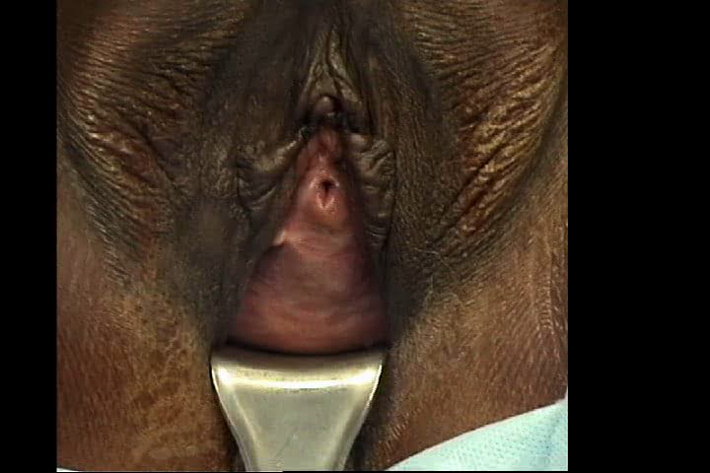

Slide 12
PFMT for POP-how might this work?
“patient may experience relief of symptoms”
“may strengthen muscles and prepare patient for normal function after surgery”
“if POP reduces by a PFM contraction this is a good indicator for Kegels”
                Baden Walker 1992, Kegel 1948

Slide 13
PFMT for POP-how might this work?
Hypertrophy of musculature by strength training and improve timing of contractions against increases in IAP(Bo 2006)
Differences in PFM between women with and without POP (DeLancey 2007, Borello-France 2007)
Differences in urogenital hiatus between women with and without POP (DeLancey 1998, Athanasiou 2007, Dietz 2008)
Increase muscle volume, shorten muscle length, improve closure of urogenital hiatus (Braekken 2010)
Notes:
Hypertrophy: DeLancey (2007) showed changes in levator ani between women with and without POP – women with POP more often have defects and generate less vaginal closure force during a max contraction than controls. Borello-France 2007 showed that women with less advanced prolapse were somewhat better able to elevate their pelvic floor during pelvic muscle contraction than women with more advanced prolapse. Second, women in the lower Brink scale quartile had larger genital hiatus measurements when straining. Advancing prolapse could cause passive stretch and impaired contractility of the pelvic-floor muscles. It is possible that pelvic floor muscle dysfunction could both contribute to the development of prolapse and represent a consequence of prolapse. By the time women reach clinical care for prolapse, it is not possible to determine which came first.
Bo – improving PFM may “build up structural support of the pelvis by elevating the levator plate to a permanently higher location inside the pelvis and by enhancing hypertrophy and stiffness of the PFM and connective tissue...thus preventing descent during increased intra-abdominal pressure. Plus the knack i.e. theory of PFMT for urinary incont.
Braekken showed that PFMT can close the levator hiatus. In her study of PFMT for POP using 3-D ultrasound she showed that the hiatal area at max valsalva was reduced (indicating increased muscle stiffness).

Slide 14
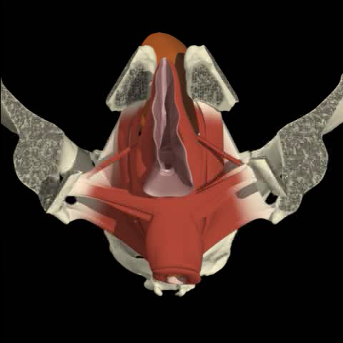

Slide 15
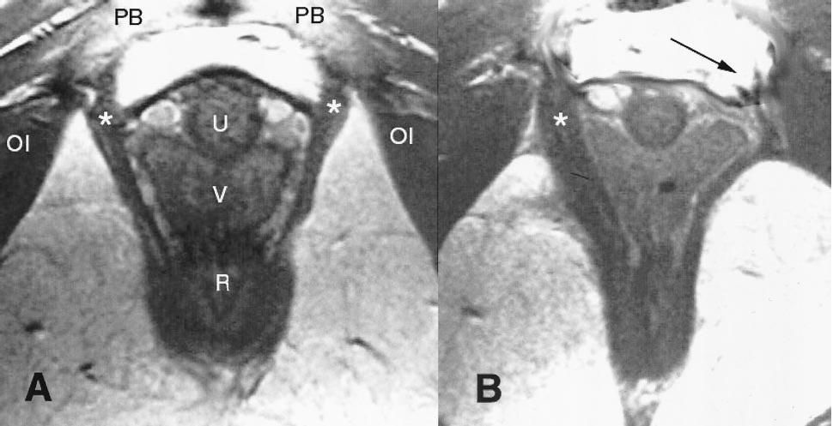
Lein et al (2004) MRI showing pubovisceral muscle damage (with permission from authors)

Slide 16
Research aim
To determine the effectiveness and cost-effectiveness of pelvic floor muscle training in the management of pelvic organ prolapse
  effective in reducing prolapse symptoms, severity and need for further treatment, and is it cost-effective?
Population: newly diagnosed women with POP-Q stage I, II or III prolapse of any type
  Prolapse symptoms primary complaint
  Not pregnant or < 6 months post-natal
Notes:
Pragmatic trial, started feasibility work for this in 2002 – all types of prolapse of prolapse, symptoms the main focus

Slide 17
Trial
process
New outpatient notes screened
Woman attends clinic
Gynae. assesses prolapse, completes GAF-A,
gives Patient Information Leaflet
Eligible, agreeable women contacted by Trial Office
Consenting women complete baseline questionnaire
and are randomised
PFMT (appoint at 0, 2, 6, 11 & 16 wks) or control (lifestyle leaflet)
6 months: re-assessed at clinic by gynaecologist,
Complete GAF-B, discuss further treatment
6 and 12 months: follow-up questionnaire

Slide 18
Trial quality assurance
Trial Steering Committee with consumer representation
Data Monitoring and Ethics Committee
Remote randomisation system and data management (CHaRT)
Minimisation: centre, POP-Q stage, whether woman considering surgery or not
Blinded prolapse assessment at follow-up
Blinded data analysis
Pre-specified statistical analysis plan
Intervention training day for physiotherapists
Centre initiation visits, including POP-Q teaching

Slide 19

Outcome Measures
postal questionnaires: baseline, 6 & 12 months
  prolapse symptoms (7 item POP-SS, scored 0-28)
  number of days with prolapse symptoms
  perceived change in prolapse
  further prolapse treatment
  urine, bowel, sexual symptoms (ICIQ, PISQ-12)
  pelvic floor exercise practice
  lifestyle changes
  use of health services
prolapse assessment (POP-Q)
  baseline and blinded at 6 months
Notes:
Women could discuss wt their gynae at 6 months other treatment required

Slide 20

PFMT
group
16 weeks
Taught exercises, lifestyle advice
Control group
No physio contact
Lifestyle leaflet only
5 physio appointments
Home exercise programme
women with
stage I, II, III prolapse

Slide 21
PFMT Intervention
16 weeks duration
5 appointments: weeks 0, 2, 6, 11 & 16
Clinically pragmatic model
Specialist pelvic floor physiotherapists
Standardisation of content/ training day
Control group: leaflet by post with advice on decreasing intra-abdominal pressure
Notes:
physiology of muscle changes wt exercise – duration
At the initial appointment these key areas were thoroughly covered. Pelvic floor exercise teaching included a description of anatomy and function of the pelvic floor and a description of types of prolapse. Slow and fasttwitch exercises and counterbracing were taught. The PERFECT scheme for pelvic floor muscle assessment was carried out. This PERFECT assessment ensured muscle strengthening principles of specificity and overload were met and was used to determine the HEP.
At all subsequent appointments these same key areas were repeated. Symptom changes, lifestyle changes and exercise compliance were recorded. The PERFECT assessment (power endurance repetition fast - every contract timed) was repeated and the HEP adjusted as necessary.
lifestyle leaflet given also

Slide 22
Physiotherapy Assessment Form
Patient Details
Appointment Record
General Medical History
Obstetric History
Gynaecological History
Prolapse Symptoms
Urinary Symptoms
Bowel Symptoms
Examination
Assessment/Treatment Plan
  Prolapse Risk Factors
  Problem list
  Treatment/advice given
  Daily PFE’s programme recommended
  Plan/questions for next time
  Return appointments
Notes:
Adherence with

Slide 23
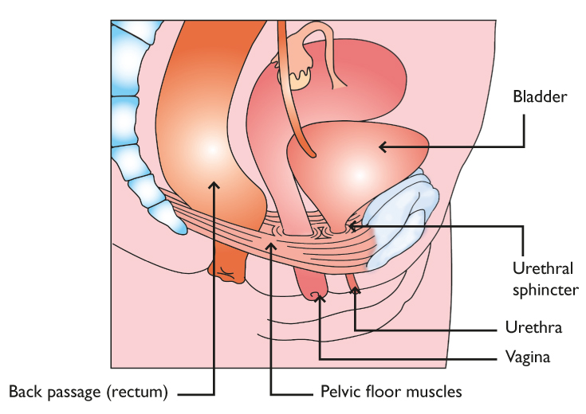
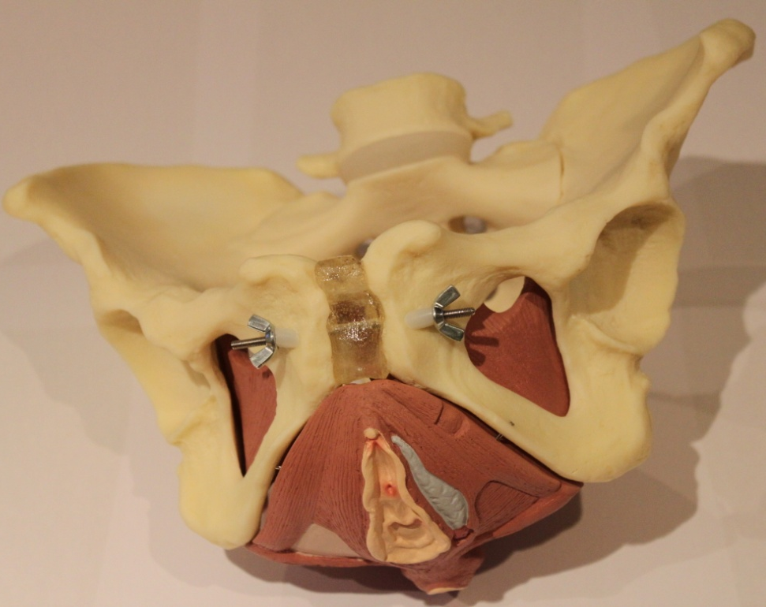
Pelvic floor muscle exercise teaching
Internal pelvic floor muscle assessment (PERFECT assessment)
Individualised home exercise programme
Lifestyle advice
Notes:
At the initial appointment these key areas were thoroughly covered. Pelvic floor exercise teaching included a description of anatomy and function of the pelvic floor and a description of types of prolapse. Slow and fast twitch exercises and counterbracing were taught. The PERFECT scheme for pelvic floor muscle assessment was carried out. This PERFECT assessment ensured muscle strengthening principles of specifity and overload were met and was used to determine the HEP. Perfect 2001, altered to include vertical plane 2008 (too late for POPPY main trial)
At all subsequent appointments these same key areas were repeated. Symptom changes, lifestyle changes and exercise compliance were recorded. The PERFECT assessment was repeated and the HEP adjusted as necessary.

Slide 24
Multi-centre trial
Original UK centres:
Aberdeen Royal Infirmary
Belfast City Hospital
Borders General Hospital
Crosshouse Hospital
Falkirk and District Royal Infirmary
Forth Park Hospital, Fife
Glasgow Royal Infirmary
Ninewells Hospital
Royal Infirmary of Edinburgh
Southern General Hospital
St John's Hospital, Livingston
St Mary's Hospital, Manchester
Victoria Infirmary, Glasgow
York Hospital
New UK Centres:
James Cook University Hospital
Bradford Royal Infirmary
St James’ University Hospital
Antrim Area Hospital
Addenbrooke’s Hospital, Cambridge
Birmingham Women’s Hospital
Worcestershire Royal Hospital
North Hampshire Hospitals NHS Trust, Basingstoke
Chester Hospital
Castle Hill Hospital, Hull
International:
Dunedin, New Zealand
St George Hospital, Sydney

Slide 25
Summary of Recruitment
447 randomised
603 eligible
2093 women approached
1490 ineligible
156 withdrawn pre-randomisation
Notes:
To summarise, 2093 women in total were approached (this may be an underestimate as some centres only returned GAF-A’s for eligible women, other centres returned GAF-A’s for all women approached)
Of the 2093 approached, 1490 were not eligible.
The main reasons for this ineligibility were:
a wish for surgery, PFMT or pessary,
no interest in the Trial,
previous treatment for prolapse (surgery, formal instruction in PFMT within the last 5 years or pessary, within the last 12 months).
So 603 women were eligible. There were 155 withdrawals pre-randomisation. These were women who, when asked by the gynaecologist, in the hospital, if they wished to take part said yes but when called by the Trial Office had changed their minds and no longer wished to take part.
Adverse Events
9 reported in total - all unrelated to the Trial and all treated or resolved without treatment.
One Serious adverse event was reported to the DMEC. This patient broke an arm and leg while on holiday skiing. She was in hospital for 10 days and her PFMT was delayed as a result.
Two patients fell pregnant – one in each group.
Some of you may notice my numbers don’t add up. This is because we randomised 448 women but one woman subsequently withdrew and asked us not to use her data in the analysis.
Women who had urogenital atrophy requiring treatment with local oestrogens (after an 8 week course of local oestrogen such women were included);

Slide 26
Recruitment Timeline
July 2007 - First Site Visit (Southern General Hospital)
September 2007 - Southern General Hospital randomises first participant.
March 2009 – Last Site Visit (Worcestershire Royal Hospital)
April 2010 – Last participant randomised to Trial (James Cook University Hospital)

Slide 27
Randomised groups
Intervention
225
Control
222
Total randomised
447

Slide 28
Reasons for not adhering to group allocation
Intervention
30
Control
20
Unhappy with group allocation, requested referral for treatment
Symptoms getting worse, wishing treatment
Not motivated to exercise and referral requested for surgery/pessary
Wanted physio locally
Too busy with work/family commitments to attend physio

Slide 29
Baseline Characteristics
Age (mean)
Number of births (median)
Duration of Symptoms (median)
56.8yrs (SD 11.5)
2 (range 0 – 7)
12 months (IQR 6 – 24)
No clinical or demographic differences between the randomised groups at entry

Slide 30
Trial process adherence
Intervention Control

Slide 31
Change in POP-SS from baseline
 | Intervention | Control
Baseline | 10.04 (6.00) N=224 | 9.51 (5.64) N=222
6 months | 6.56 (5.09) N=188 | 9.17 (5.81) N=189
12 months | 5.74 (4.89) N= 145 | 7.04 (5.43) N=139
Notes:
The POP-SS at 12 months was our primary outcome. This table shows how the mean POP-SS scores changed from baseline, to 6 and then 12 months.
Using a repeated measures linear mixed effects model which adjusted for baseline POP-SS score and the minimisation variables (baseline stage, centre and whether considering surgery or not) the difference between groups in change in POP-SS score from baseline was estimated.

Slide 32
Change in POP-SS from baseline
 | Intervention | Control | Mean diff, 95% CI
Baseline | 10.04 (6.00) N=224 | 9.51 (5.64) N=222
6 months | 6.56 (5.09) N=188 | 9.17 (5.81) N=189 | 2.84 (2.05, 3.63) P= 0.001
12 months | 5.74 (4.89) N= 145 | 7.04 (5.43) N=139 | 1.52 (0.46, 2.59) P=0.005
Notes:
The POP-SS at 12 months was our primary outcome. This table shows how the mean POP-SS scores changed from baseline, to 6 and then 12 months.
Using a repeated measures linear mixed effects model which adjusted for baseline POP-SS score and the minimisation variables (baseline stage, centre and whether considering surgery or not) the difference between groups in change in POP-SS score from baseline was estimated.

Slide 33
Additional treatment by 12 months
 | Intervention (n=145) | Control (n=140) | P value
Surgery | 16 (11%) | 14 (10%) | 0.848
Pessary | 8 (6%) | 15 (11%) | 0.130
Physiotherapy referral | 2 (1%) | 36 (26%) | <0.001
Oestrogen, drugs, other | 14 (10%) | 15 (11%) | 0.846
Notes:
% percent of women had received additional treatment for prolapse by 12 month and this was statistically more likely in the control group. Specifically control women were more likely to have received a physio referral by 12 months.

Slide 34
Change in POP-SS from baseline
 | Intervention | Control | Mean diff, 95% CI | Mean diff, 95% CI adjusted*
Baseline | 10.04 (6.00) N=224 | 9.51 (5.64) N=222
6 months | 6.56 (5.09) N=188 | 9.17 (5.81) N=189 | 2.84 (2.05, 3.63) P= 0.001
12 months | 5.74 (4.89) N= 145 | 7.04 (5.43) N=139 | 1.52 (0.46, 2.59) P=0.005 | 2.38 (1.32, 3.45) P <0.001
* Adjusted for the whether not a woman received additional prolapse treatment
Notes:
If we adjust for the effects of having additional treatment in our model we see that the difference between the trial groups due to the intervention increases at 12 months, and is similar to that observed at 6 months

Slide 35
Notes:
Feeling of something coming down – the additional reduction in score of 2.38 experienced by the intervention group equates to moving from all of the time to occasionally or some of the time.
Hawthorne effect, leaflet, exercise of own accord

Slide 36
Change in POP-Q stage from baseline to 6 months
 | Change in stage | Intervention N=168 | Control N=171
Worse | +2 stages | 2 (1%) | 2 (1%)
 | +1 stages | 20 (12%) | 28 (16%)
 | no change | 113 (67%) | 120 (70%)
Better | -1 stage | 32 (19%) | 21 (12%)
 | -2 stage | 1 (1%) | 0
Mann Whitney test p=0.052

Slide 37
-3 cm
Stage 0
-[tvl - 2] cm
internal
Stage I
-1 cm
-1 cm
Stage II
Hymen
+1 cm
+1 cm
Stage III
external
+[tvl - 2] cm
Stage IV
BLUE reference measurements apply for all points
RED for points Aa, Ba, Ap, Bp only
GREEN for points C and D only

Slide 38
Other prolapse outcomes
 | 6 months |  |  | 12 months
 | Intervention | Control | P value* | Intervention | Control | P value*
Feeling of something coming down “never” in last 4 weeks | 26.5% (49/185) | 13.4% (25/187 ) | <0.001 | 29.5% (41/139) | 26.1% (36/138 ) | 0.089
Symptoms “none of the time” in last 4 weeks | 25.9% (48/185) | 12.9% (24/186) | <0.001 | 33.6% (48/143) | 25.2% (35/139) | 0.023
Self-reported change in prolapse | N=187 | N=189 |  | N=145 | N=141
Better | 98 (52%) | 32 (17%) | 0.001 | 83 (57%) | 63 (45%) | 0.012
The same | 77 (41%) | 114 (60%) |  | 49 (34%) | 52 (37%)
Worse | 12 (6%) | 43 (23%) |  | 13 (9%) | 26 (18%)
* Unadjusted analyses

Slide 39
Bladder and bowel symptoms
 | 6 months |  |  | 12 months
 | Intervention | Control | P value* | Intervention | Control | P value*
Urine symptoms in the last 4 weeks:
Urine leakage | 54.8% (103/188) | 71.6% (71.6%) | 0.001 | 54.5% (72/132) | 60.2% (77/128) | 0.430
ICIQ-SF UI score | 3.41 (4.33), n=183 | 5.03 (4.72), n=181 | <0.001 | 3.22 (4.20), n=126 | 3.90 (4.32), n=126 | 0.118
Bowel symptom reported “never” in last 4 weeks:
Faecal urgency | 48.9% (92/188) | 39.7% (75/189) | 0.041 | 51.5% (67/130) | 43.7% (55/126) | 0.120
Faecal incontinence | 77.7% (146/188) | 75.1% (142/189) | 0.479 | 82.3% (107/130) | 73.2% (93/127) | 0.072
* Unadjusted analyses

Slide 40
Effectiveness conclusions
Individualised PFMT was effective in reducing women’s prolapse symptoms at 12 months compared to a lifestyle advice leaflet
There was a tendency towards improvement in POP-Q stage in the intervention group

Slide 41
Costs of intervention | Costs of additional treatment | Savings from additional treatment avoided
5 appointments (4 hours) with Band 6 physiotherapist @ £30.67 per hour = £122.67 per woman | Surgery: 1% require surgery @ £1044 per procedure | Pessary: 5.2% avoid pessary @ £229.45 per pessary (incl. fitting and follow-up)
Overheads @ £16 per appointment for 5 appointments = £80 per woman |  | Referral: 24.3% avoid physiotherapy referral @ £170.24 per woman
↓ | ↓ | ↓
Total cost per woman attending average 4.2 appointments = £170.24 | + £10.44 | - £11.93 - £41.37
Net cost = £127.38

Slide 42
Cost effectiveness
Cost net of saving for further treatment received/avoided, was £127 per woman
This cost is set against an average difference in POP-SS change at 12 months of 2.37, which represents a clinically important change in symptoms for women
Assuming QoL benefit of 10% for 1 year for the excess of 12% of intervention women who reported prolapse better at 12 months, cost per QALY = £10,615
Notes:
Cost net of savings £127
2 year follow up

Slide 43
Cost-effectiveness conclusions
The net cost of intervention was low and cost-per QALY is likely to be acceptable to decision makers
PFMT is likely to be a cost-effective intervention to offer women with prolapse

Slide 44
Appointments attended

Slide 45
Exercise diaries returned

Slide 46
Lifestyle advice followed?

Slide 47
PFE advice followed?

Slide 48
PFM strength at 1st appointment

Slide 49
PFM endurance at 1st appointment

Slide 50
PFM repetitions at 1st appointment

Slide 51
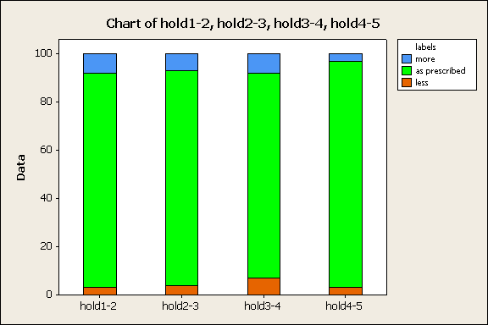
Adherence to length of hold

Slide 52
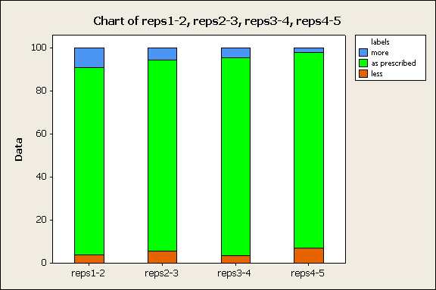
Adherence to number of repetitions

Slide 53
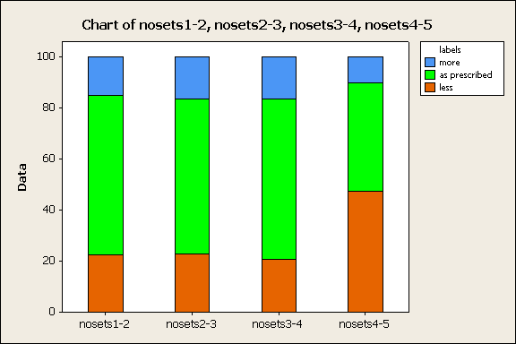
Adherence to number of sets

Slide 54
PFM strength change
median @ 1st appointment = 3; median @ 5th appointment = 3.5
Notes:
Power median = 3 at first appt to 3.5 at 5th appt (N=114)
Repeated measures ANOVA – significant improvement in strength

Slide 55
PFM endurance change
median @ 1st appointment = 6; median @ 5th appointment = 10
Notes:
Endurance median at first appt=6.0 and at last appt = 10 (N=113)
Repeated measures ANOVA – significant improvement in endurance

Slide 56
PFM repetitions change
median @ 1st appointment = 5; median @ 5th appointment = 10
Notes:
Reps median at first appt = 5 and at last appt = 10 (N=110)
Repeated measures ANOVA – significant improvement in reps

Slide 57
In summary
Adherence was very good overall
Adherence to process:
  Attending appointments good, better than returning diaries
Adherence to advice
  Lifestyle advice better than PFE advice
Many women had reasonable PFM function to start with
Adherence with prescribed length of hold and number of reps better than number of sets
Intervention group experienced significant improvement in strength, endurance and reps

Slide 58
Further analysis.....
How adherence impacts on outcomes e.g.
Link between PFM changes (strength, endurance and repetitions) and POP-SS or POP-Q
Long term adherence with PFMExs
6 and 12 month questionnaire data: Have you done any PFME in the last 4 weeks? If yes – how often? How many? Counterbracing?
Did completion of optimum number of weeks muscle training result in better PFM changes?
How many women completed 15 weeks minimum from 1st to final PFM assessment? Did they have better strength changes than those who had less time?

Slide 59
Overall conclusions
Significant difference in symptom (POP-SS) improvement at 6 and 12 months in favour of intervention group
There was a tendency towards more improvement in POP-Q stage in the intervention group
Additional benefits to the intervention group at 6 months of fewer urinary and bowel problems
PFMT is likely to be a cost-effective intervention to offer women with prolapse
PFMT is an effective and cost-effective intervention to offer women with prolapse

Slide 60
Planned subgroup analyses
Stage of prolapse
Type of prolapse (anterior, posterior, apical)
Attitude towards surgery

Slide 61
Conclusions
Individualised PFMT was effective in reducing prolapse symptoms at 12 months compared to lifestyle advice leaflet
Net cost of intervention was low and cost-per QALY is likely to be acceptable to decision makers
PFMT is an effective and cost-effective intervention to offer women with prolapse

Slide 62
Thank you to the following:
Kirsty Simpson
Ann Gilchrist
Janice Falconer
Isobel McNeil
Christine Adamson
Linda Haworth
Morag Bradley
Lynne Henderson
Irene Pullar
Carolyn Davie Lyndsey Graham
Helen Arnold
Seonaid Bradford
Karen McCulloch
Lucy Pyart
Sheila Hedley
Kate Leishman
Michelle Horridge
Lynn Moffat Kate Lough
Julie Lang
Dianne Naylor
Pauline Bibby
Sally Stevens
Gill Brook
Nina Bridges
Ros Davies
Wendy Hayes
Gail Hyland
Penny Nixon
Gynaecologists
Prof Don Wilson Dr Helen Paterson
Dr Tony Smith
Dr Christopher Hardwick
Dr John Tierney
Dr Nicola Dean
Dr Adrian Evans
Dr Ben Adekanmi
Dr Aethele Khunda
Dr Paul Ballard
Dr Pallavi Latthe
Dr Phil Toozs-Hobson
Dr Lynne Rogerson
Dr Christine Landon
Dr Carmel Ramage
Mr Paul Moran
Dr Tim Sayer
Dr Kate Moore
Dr Emmanuel Karantanis
Dr Mark Slack
Dr Chris Bain
Dr Mohamed Abdel-Fattah
Dr Kevin Cooper
Dr Robin Ashe
Dr Marie Casement
Dr Mohamed Abdel-All
Dr Brian Magowan
Dr Roddy Campbell
Dr Queenie Menezes
Dr David Rae
Dr Kate Patrick
Dr Klara Ekevall
Dr Laxmi Prabhu
Dr Hilary MacPherson
Dr Ian Ramsay
Dr Carolyn McKinley
Dr Chu Lim
Dr Mahesh Perera
Dr Mary Rodger
Dr Miriam Deeney
Dr Vanessa Kay
Dr Julie Christie
Dr Lucia Dolan
Dr Stewart Pringle
Dr Robert Hawthorn
Dr Hassan Ali
Dr Paul Dewart
Dr Simon Nicholson
Dr Sanjay Kallat
Screeners
Karen Richardson
Margaret MacNeil
Gynaecology Secretaries, Borders General Hospital
Edith Strawhorn
Margaret Thomson
Kathleen Riddle
Linda Malone
Fatima Goulter
Nina Crane
Susan Ebrahimi
Gaye Ellis
Laura Summersgill
Anne Harburn
Kim Powles
Jackie Moody
Anne Bates
Sue Payne
Helen Boyer Joanne Bean Hazel Dutton
Physiotherapists
Faith Jakeman
Carolyn Hosker
Helen Bentley
Christine Adams
Angela Wilkin
Maria Ineson
Ann Johnson
Karen Anderson
Jennifer Corbett
Sandra Whyte
Alison Aitchson
Elizabeth Crothers
Barbara Pilling
Doreen McClurg
Fiona Grant
Alison Hennessay
Alison Anderson
Jodie Edwards
Dr Fiona Reid
Sally Martineau
Clare Haslam
Elaine Crombie
Kirsty Moore

Slide 63
TSC Members
Research Team
Chris Mayne (Chair)
Helena Frawley
June Jenkins
Muriel Nugent
Suzanne Hagen
Diane Stark
Charis Glazener
Sylvia Dickson
Janet Logan
Alison McDonald
Gladys McPherson
Lesley Sinclair
Don Wilson
John Norrie
Andrew Walker
Sarah Barry
DMEC Members
Doug Tincello (Chair)
Karen Ward
Chris Weir
Becky Aston

Slide 64

Intervention = 225
Control = 222
Thank you!

